Slide 1
Basic DMX & Art-Net controls in Node.js
Making the things that light the things do the things

Slide 2
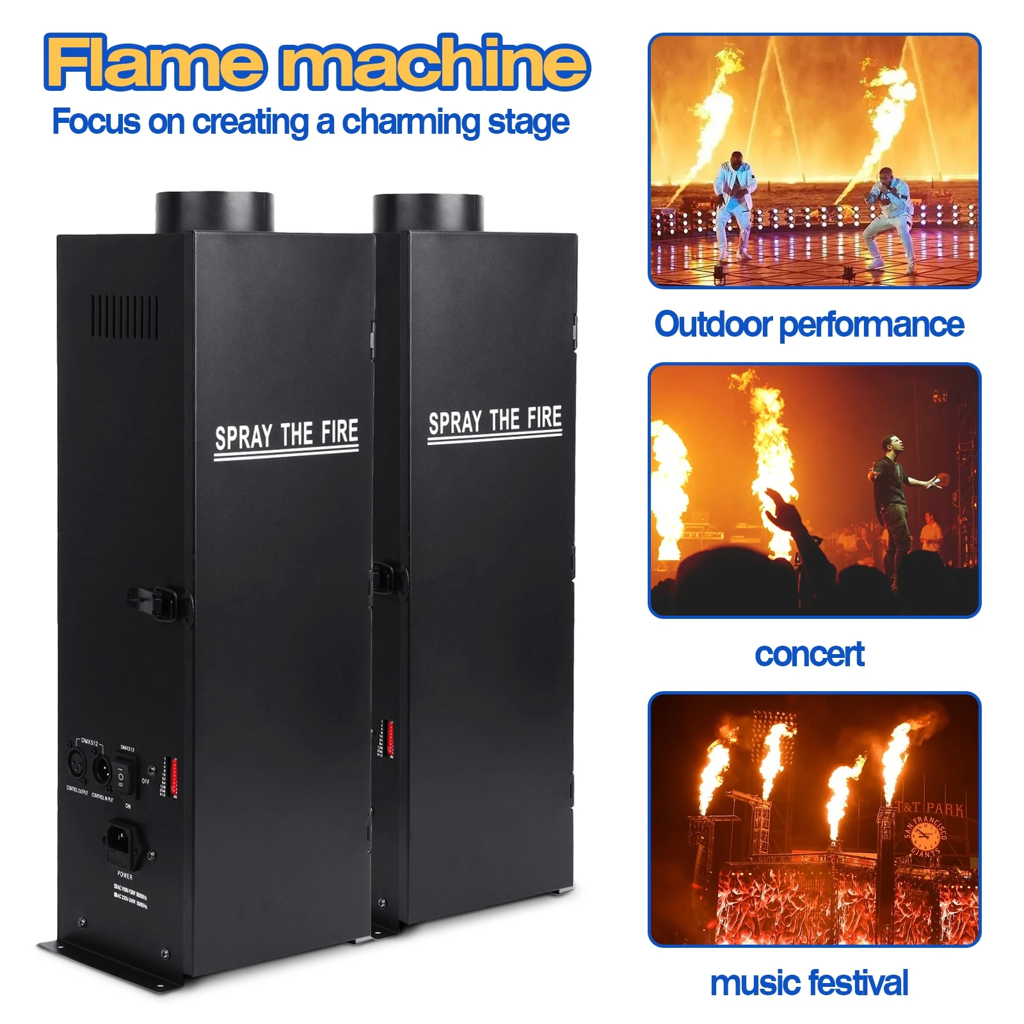
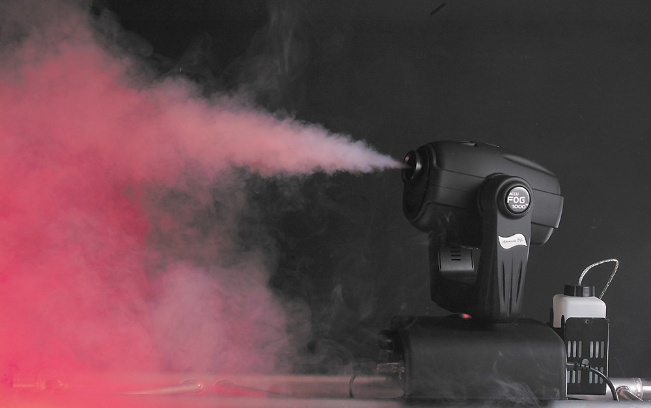
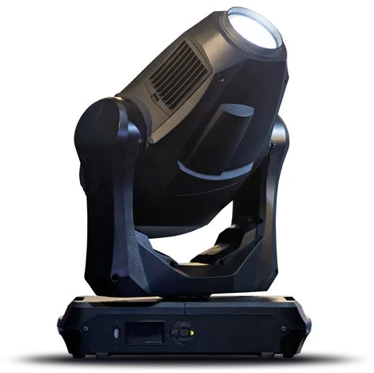
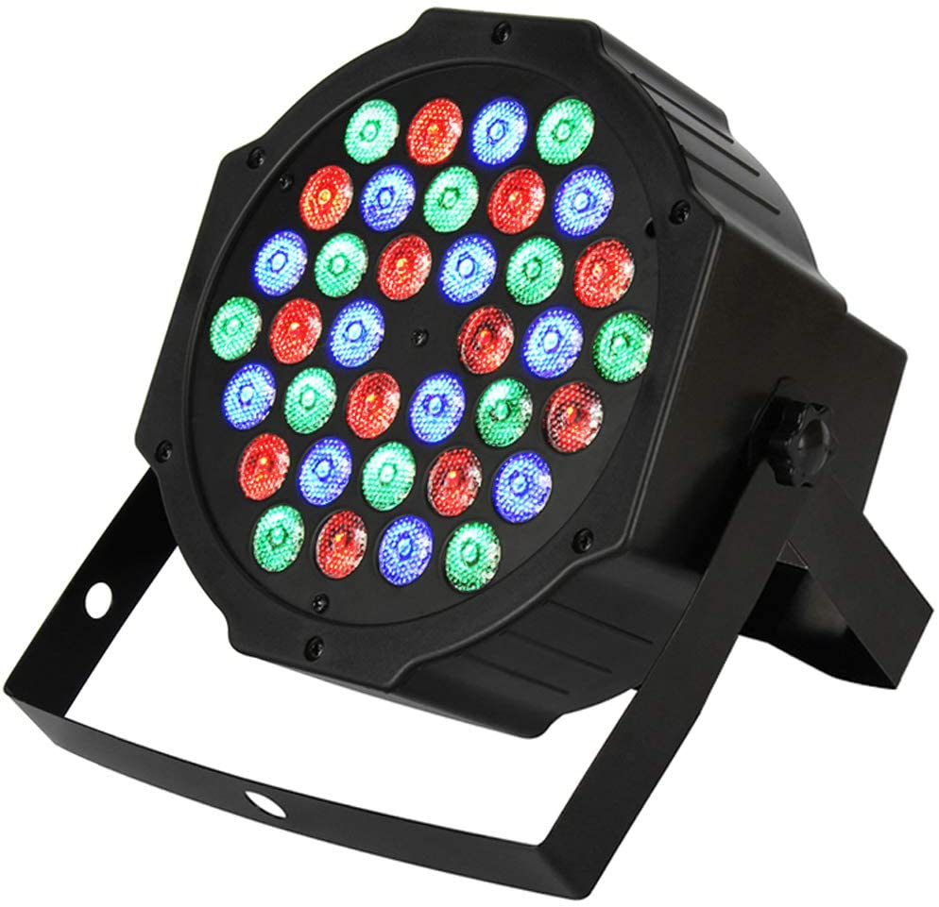
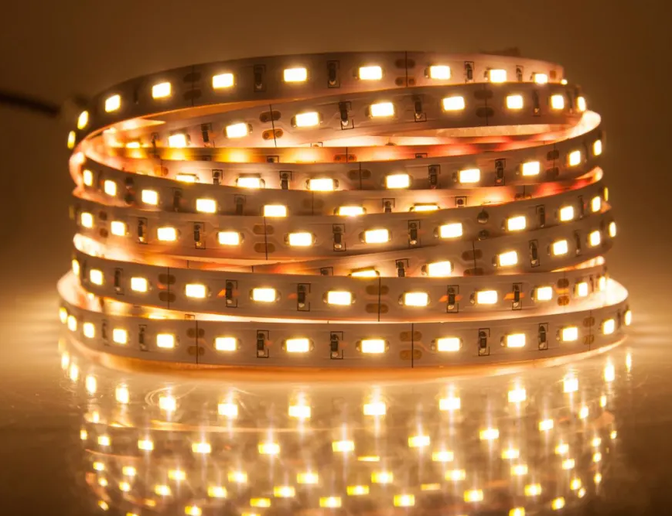
What can you do with DMX & Art-Net
Control safe stuff
Led Lights
Light heads with motors and effects
Fog machines
Other special effects
Control not as safe stuff
Pyrotechnics
Rigging
DMX has no error correction and is super reconfigurable (aka easily misconfigurable)

Slide 3
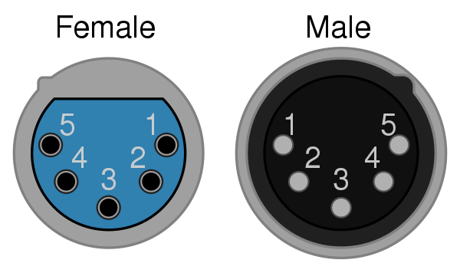
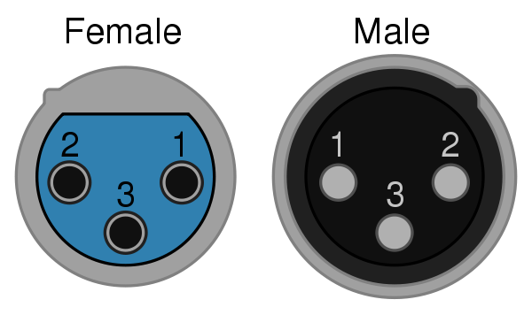
DMX Spec vs Reality
DMX512-A specifies that the connector must be a five-pin XLR connector.
Valid DMX connector
Banned in 2008
This is the one we have used most often.
Do not plug into peoples audio equipment.

Slide 4
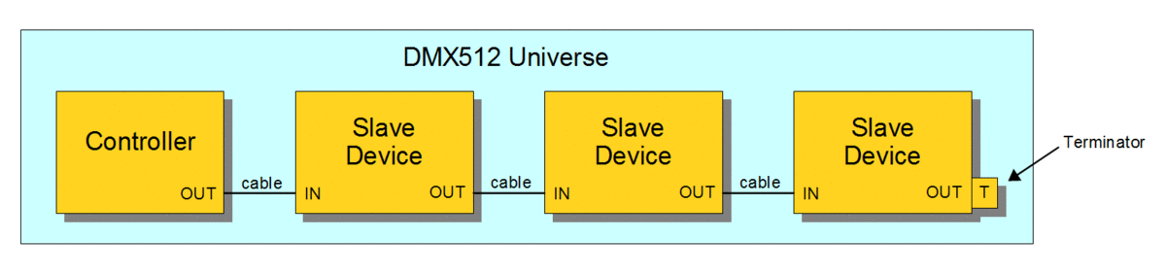
DMX Spec vs Reality
DMX512-A specifies that the universe must be terminated with a 120ohms resistor between the data pair
Some devices are self terminating
Sometimes it works fine if there is no termination

Slide 5
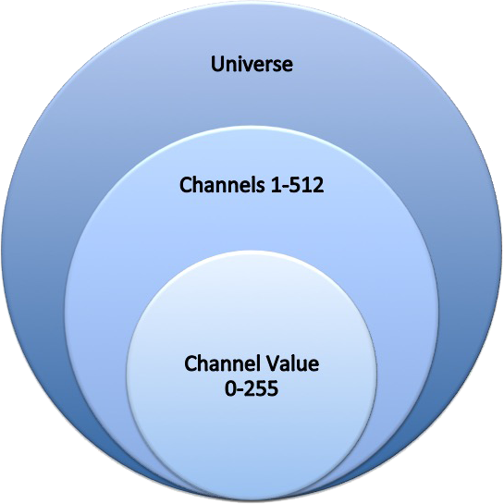
DMX Universes and Channels
DMX devices are grouped into universes
We rarely use more than 1
Each device will use a slice of the channels
For example a single RGB light strip uses 3 channels, 1 for red, 1 for blue and 1 for green
RGBW uses 4 channels, 1 more for the white
An led moving head light can use 9-11 channels
Note these are 1 indexed, not 0
Each channel is 8bit so 256 values 0-255
Most of the complexity of dmx is in managing the channels

Slide 6
Art-Net
Basically just a UDP version of DMX512-A
Useful for:
Complicated runs where addressing with ips is easier or more stable
Long runs where the dmx signal would be a challenge to maintain
When a network is available to connect isolated components
Devices easily convert Art-Net to DMX

Slide 7
npm dmx
https://www.npmjs.com/package/dmx
Simple interface
const dmx = new DMX();
dmx.registerDriver('main', 'enttec-usb-dmx-pro');
var universe = dmx.addUniverse('u1', 'enttec-usb-dmx-pro', 'COM16');
universe.update({1:255,2:0,3:0});

Slide 8
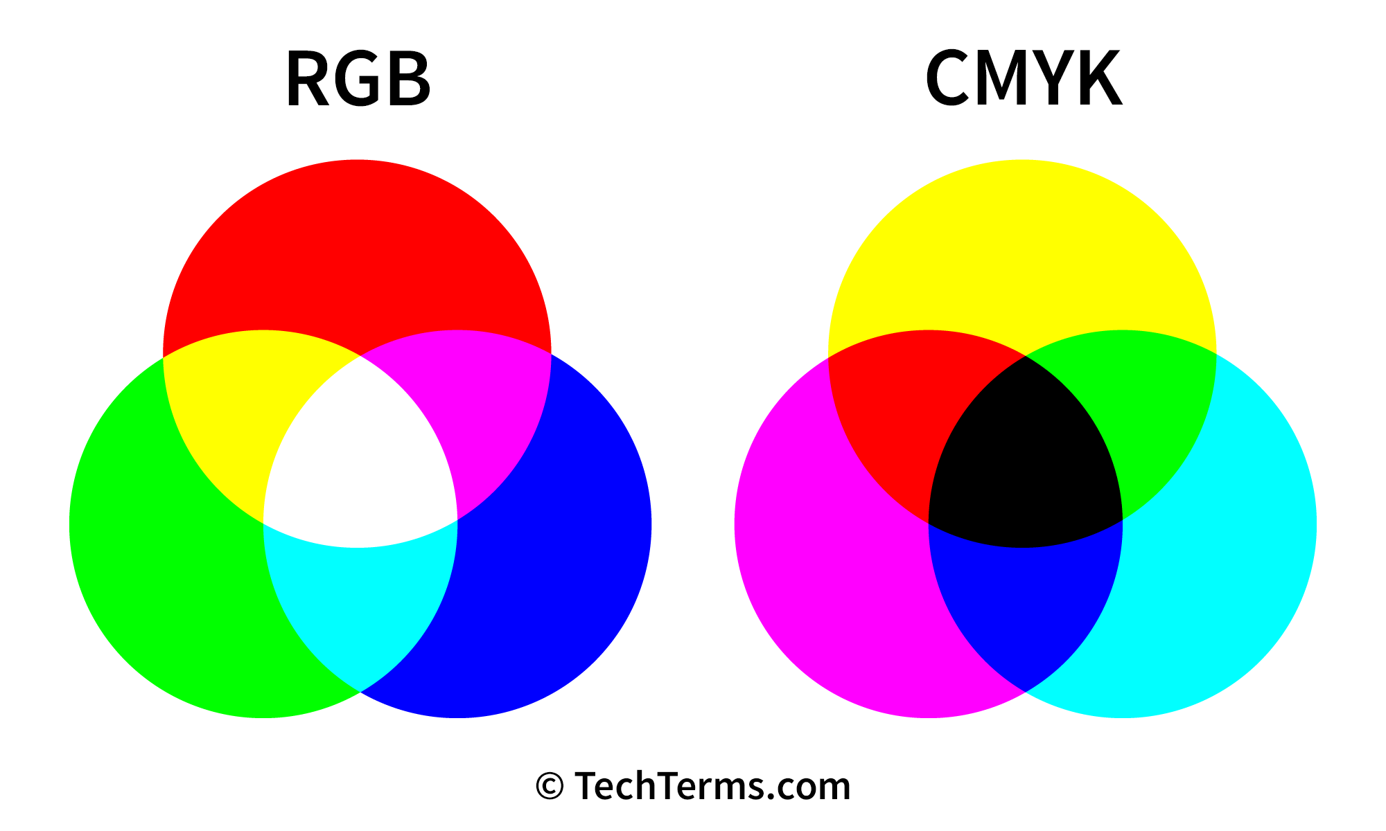
RGB
Super common, super cheap, super effective
const DMX = require('dmx');
const dmx = new DMX();
dmx.registerDriver('main', 'enttec-usb-dmx-pro');
var universe = dmx.addUniverse('u1', 'enttec-usb-dmx-pro', 'COM16');
dmx.update(universe, {1:255,2:0,3:0,4:0,5:255,6:0,7:0,8:0,9:255});
{1:255,2:0,3:0,4:0,5:255,6:0,7:0,8:0,9:255}
{1:0,2:255,3:255,4:255,5:0,6:255,7:255,8:255,9:0}
{1:255,2:255,3:255,4:255,5:255,6:255,7:255,8:255,9:255}

Slide 9
Addressing and Dip Switches
The dips switches offset the starting channel of the device
Dmx is 1 indexed, on most devices 0 = 1
Dip switches are binary values
1 = 1
2 = 2
3 = 4
4 = 8
1 + 4 = 9
3 + 4 = 12
1+2+3 = 1+2+4 = 7
A device does not modify the channels values after it

Slide 10
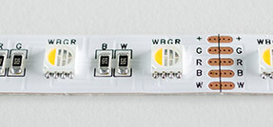
RGBW
Super common, super cheap, super effective
const DMX = require('dmx');
const dmx = new DMX();
dmx.registerDriver('main', 'enttec-usb-dmx-pro');
var universe = dmx.addUniverse('u1', 'enttec-usb-dmx-pro', 'COM16');
dmx.update(universe, {1:255,2:0,3:0,4:0});
{1:255,2:0,3:0,4:0}
{1:0,2:255,3:0,4:0}
{1:0,2:0,3:255,4:0}
{1:0,2:0,3:0,4:255}
{1:255,2:255,3:255,4:255}

Slide 11
DMX Addressable Lighting
Basically the same thing but each led is it’s own 3 channels (assuming rgb)
Uses many more channels, only 170 rgb leds can fit in a universe
RGB 512/3 = ~170
RGBW 512/4 = 128
Addressables send data down the data line to set the pixels state
The clock line is used to tell the pixels the signal is valid, this makes it so the signals don’t need super tight timing, clock isn’t always required

Slide 12
DMX Animations
A simple animation object is available in does dmx
Runs on the host machine
const DMX = require('dmx');
const dmx = new DMX();
dmx.registerDriver('main', 'enttec-usb-dmx-pro');
var universe = dmx.addUniverse('u1', 'enttec-usb-dmx-pro', 'COM16');
const on = {1:255,2:255,3:255,4:255,5:255,6:255,7:255,8:255,9:255};
const off = {1:0,2:0,3:0,4:0,5:0,6:0,7:0,8:0,9:0};
animation = new DMX.Animation().add(on, 500).add(off, 500).runLoop(universe);

Slide 13
Art-Net to DMX
https://dmxking.com/downloads-list
DMX over UDP
Some devices support artnet and dmx
const DMX = require('dmx');
const dmx = new DMX();
dmx.registerDriver('main', 'artnet');
var universe = dmx.addUniverse('u1', 'artnet', '192.168.0.4');
universe.update({1:255,2:0,3:0}); // R

Slide 14
Art-Net Addressable
Almost no different than using dmx to addressable lights with less gear
Timing sensitive strips might not be using the clock pin
Commonly 5v, if you give them 12v they break

Slide 15
Final Notes
Remember channel limits in universe
Check the voltages, it’s not uncommon for addressables to be 5v
Lights get hot when wrapped up
Remember the dip switches and channels are 1 indexed
Don’t trust wire colors to mean anything

